Slide 1
Advanced QoS Methods for Grid Workflows Based on Meta-Negotiations and SLA-Mappings
Ivona Brandic¹, Dejan Music¹, Schahram Dustdar¹, Srikumar Venugopal², and Rajkumar Buyya²
²Department of Computer Science and Software Engineering
The University of Melbourne
¹Institute for Information Systems
Vienna University of Technology
ivona@infosys.tuwien.ac.at

Slide 2
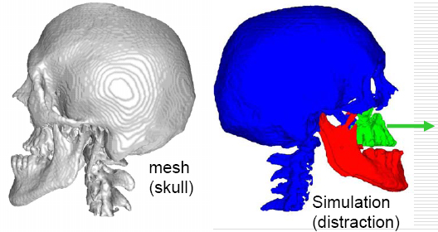
Case Study: From Grid Workflows to Clouds
Radiosurgery:
Neurosurgery
support
I can pay up to 100 €, I can start simulation today 5 p.m., I need results tomorrow 10 a.m., don‘t bother me with details…
Maxillo Facial
Surgery Simulation
Inhaled drug
delivery
simulation
Meta data
Workflow
S₁
Find matching service
provider and consumer
S₂
I am running Dutch Auction, need WS-Security, and understand WS-Agreement …
Guarantees (QoS)
S₃
Medical
practitioner
Client
…
Why workflow?
Automation of processes
Reusability, intuitive, and high-level modeling
I am running Alternate Offers Negotiation, need GSI, and understand WSLA …
S_{n}
Services

Slide 3
Cloud Computing: Relation to Meta Negotiations & SLA Mappings
Meta-Negotiations & SLA Mappings
Case Study:
Services are configured on demand, reconfigured
Self-* characteristics
Automatic SLA management
Self-governance
…
Services
“Buyya, Yeo,
Venugopal, Broberg, Brandic”

Slide 4
Contributions
Demonstration of MN & SLA mappings using a Grid workflow case study
Definition of MN documents
Presentation of MN scenarios
Presentation of SLA mapping strategies
MN & SLA mapping architecture based on Gridbus and ANEKA
Integration of MN & SLA mapping middleware into existing WF management tool

Slide 5
Case Study: MFSS
workflow
level
A1
a) Mapping:
„price“ to
„usage price“
b) Mapping:
$ to €
A2
A3
activity
level
A4
complex
activity
level
a) Negotiation terms: begin time, end time, price
b) Security: GSI
c) Negotiation Protocol: alternate offers
d) Document Language: WSLA
e) Agreement: third party arbitrator
A5
Workflow

Slide 6
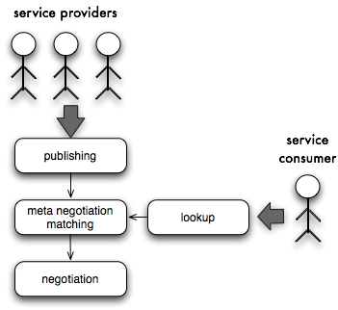
Scenario for Meta Negotiations
Pre-requisites
Security issues
Negotiation terms
Negotiation
Documents
Protocols
Agreement
Arbitrator

Slide 7
Sample Meta Negotiation Protocol
<meta-negotiation xmlns:xsi=http://www.w3.org/2001/XMLSchema-instance …>
<entity> <ID name="1234"/> … </entity>
<pre-requisite>
<role name="Consumer"/>
<security>
<authentication name="GSI"/><authorisation name="xy"/>
</security>
<negotiation-terms>
<negotiation-term name="beginTime"/> <negotiation-term name="endTime"/>
<negotiation-term name="price"/>
</negotiation-terms>
</pre-requisite>
<negotiation>
<document name="WSLA" value="uri" version="1.0”/>
<document name="WS-Agreements" value="uri" version="1.0”/>
<document name=”documentLanguageXY" value="uri" version="4”/>
<protocol name="alternateOffers" schema="uri" version="1.0” location="uri"/>
</negotiation>
<agreement>
<confirmation name="confirmator" value="arbitrator”/>
</agreement>
</meta-negotiation>

Slide 8
Example SLA Mapping & Mapping Scenario
Local
WSLA
template
Rule
From local
to remote
Rule
From local
to remote
+
Rule
from local
to remote
<xsl:template match="/ns:SLA/
ns:ServiceDefinition/
ns:WSDLSOAPOperation/
ns:Metric[@name='calculatePrice']/
ns:Function">
<ns:Function xsi:type="Times
resultType="float">
<ns:Operand>
<xsl:copy>
<xsl:copy-of
select="@*|node()"/>
</xsl:copy>
</ns:Operand>
<ns:Operand>
<ns:FloatScalar>
0.68096718
</ns:FloatScalar>
</ns:Operand>
</ns:Function>
</xsl:template>
XSLT
transformation
XSLT
transformation
Rule
From local
to remote
Rule
From local
to remote
Rule from
remote
to local
Service
consumer
+
Remote
WSLA
template
Service
provider
+
XSLT
transformation
Rule
From local
to remote
Rule
From local
to remote
Rule from
remote
to local
XSLT
transformation
Rule
From local
to remote
Local
WSLA
template
Rule
From local
to remote
Rule
from local
to remote
+

Slide 9
Meta Negotiation Architecture

Slide 10
Registry methods
PostgreSQL database (MN)
MS-SQL database (SLA mappings)
WCF services
Role-based
CRUD methods
publish(XMLdocument); update(XMLdocument);
query(XMLdocument);
getDocument(ID);
createTemplateCategory(TemCategory); createAttributeMapping(ProviderAttrMapp); createAttributeMapping(ConsumerAttrMapp); createService(Service);
findServices(ConsumerServiceRequest);

Slide 11
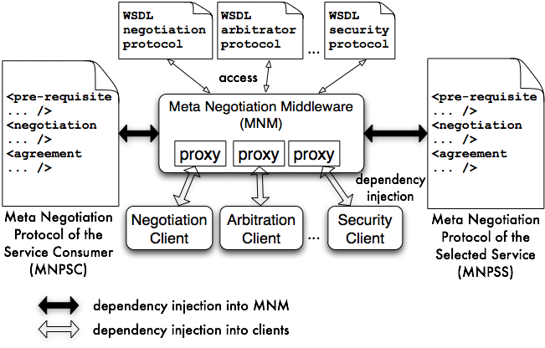
Meta Negotiation Middleware & Dependency Injection

Slide 12
SLA Mapping Middleware
Bunch of WCF services
Registry Administration Service
WSLA Mapping Service
WSLA Querying Service
…
Parsing
Language Integrated Query (LINQ) technology from .NET 3.5
Implemented based on abstract factory pattern
Transformation Service
Abstract factory pattern

Slide 13
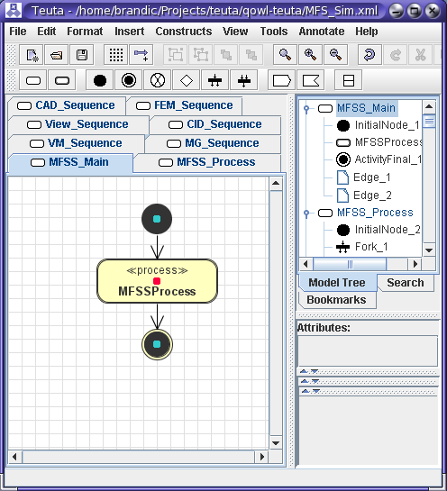
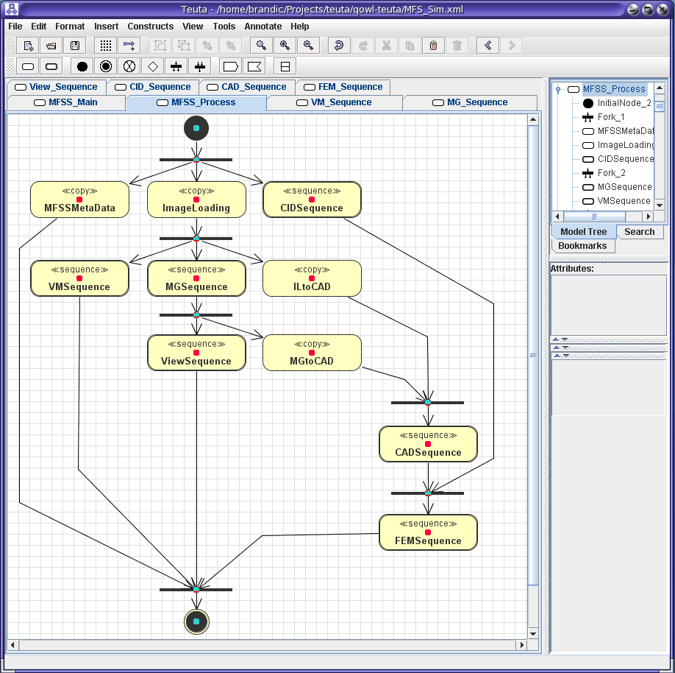
Case Study: Amadeus Workflows & ANEKA
Workflow Modeling
SLA Mapping
SLA Mapping
User Interface
WF
MND
MND
Workflow Planning and Execution Tool
Event
Notification Component
Participant specific Negotiation and Planning Component
Meta Negotiation and SLA Mapping Middleware
XML config file
Meta Negotiation and SLA Mapping Middleware
ANEKA
Meta Negotiation and SLA Mapping Middleware
Workflow Planner
Negotiator
SLA Mapping
Alternate Offers Negotiation Strategy
Negotiation Strategy
SLA Mapping
XML config file
…
Local SLA Template
MND
Local SLA Template
MND

Slide 14
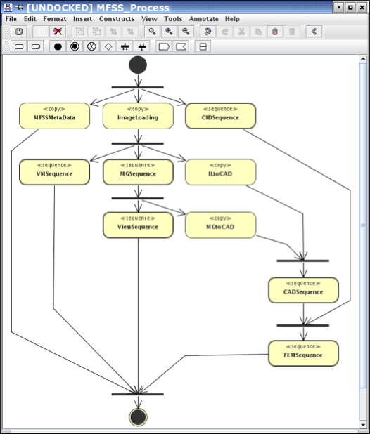
Sample Workflow
1. <sequence name="MGSequence" ... >
2. ...
3. <qos-constraints reqDescVar="..."
4. mnd="..." SLA-mapp="...">
5. <qos-constraint name="beginTime"
6. value="..."/>
7. <qos-constraint name="endTime"
8. value="..."/>
9. <qos-constraint name="price"
10. value="..." />
11. </qos-constraints>
12. </sequence>

Slide 15
Conclusion & Future Work
Conclusion
MN document & SLA mapping strategies
First prototype on MN and SLA mapping infrastructure
Integration into existing workflow management tool
Future Work
Testing MN and SLA mapping infrastructure with real world Grid workflows
Methods for protocols bootstrapping
GUI for MN documents & SLA mapping specification
Autonomic resource management & self-governing infrastructures

Slide 16
Questions & Contact information
Ivona Brandic
Distributed Systems Group
Information Systems Institute
Vienna University of Technology
Austria
email: ivona@infosys.tuwien.ac.at
http://www.infosys.tuwien.ac.at/staff/ivona/
Software Services & Systems Network
Network of Excellence (NoE)

