Slide 1
Using SchedFlow for Performance Evaluation of Workflow Applications
Elisa Heyman
Gustavo Martínez
Miquel Angel Senar
Emilio Luque
Universitat Autònoma de Barcelona
Elisa.Heymann@uab.es
Barton P. Miller
University of Wisconsin
bart@cs.wisc.edu
1
Notes:
Vulnerability Assessment and Secure Coding Practices
1

Slide 2
Our Problem
Scheduling Policies
T1
T2
T3
T4
T5
T6
T7
Workflow Engines
Notes:
Goal: reduce makespan.
Sophisticated scheduling policies. Difficult to integrate into existing workflow engines.
How do we chose a particular scheduling policy for all the cases? (workload, communication volume, etc.)

Slide 3
Our Solution
T1
Scheduling Policies
SchedFlow
T2
T3
T4
T5
T6
T7
Workflow Engines
Notes:
SchedFlow integrates scheduling policies into workflow engines (Taverna, DAGMan, Karajan).
We used different scheduling policies at different times, depending on the workload of the workflow.
Inaccurate computing/communication times.
Machines appearing and disappearing dynamically.
Flexibility when scheduling workflows.

Slide 4
Outline
Introduction
SchedFlow
Experimental Study
Conclusions

Slide 5
Introduction
For executing a workflow on a distributed environment, we need:
Scheduling policy integrated into a
Workflow engine
Reduce makespan
Factors
Workload size
Inaccurate computing and communication times
Machines appearing/disappering dynamically

Slide 6
Introduction
With SchedFlow, we assessed the influence of the workload on the makespan considering:
Different scheduling policies
Different workflow engines
Notes:
Under different workloads applications show different behaviors depending on the scheduling policy.

Slide 7
SchedFlow
T1
T2
T3
Scheduler
Scheduler
T4
T5
T6
Scheduler
Scheduler
Controller
Observer
T7
Adaptor
Adaptor
User Policy
API
queue
logs
Task manager
Scheduler
Workflow Engine
Notes:
Architecture
3 main modules: controller, observer, scheduler
2 interfaces: one for the integration of scheduling policies, and the adaptors, to link SchedFlow to a workflow engine.
Task adaptor, resource and event adaptor.

Slide 8
SchedFlow
T1
The user submits a workflow
Scheduler
T2
T3
Scheduler
Scheduler
Scheduler
Controller
Observer
T4
Adaptor
Adaptor
User Policy
API
queue
logs
Task manager
Scheduler
Workflow Engine
Notes:
8
Controller: Keep the task list. Sends the task to the Scheduler for planning. Receives answer from the Scheduler. Sends the tasks to the wrokflow engine for execution.

Slide 9
SchedFlow
The Scheduler uses the specified scheduling policy on the available resources discovered by the Observer.
T1
M1
Scheduler
T2
M2
Scheduler
Scheduler
Scheduler
T3
M3
Controller
Observer
T4
M4
Adaptor
Adaptor
queue
logs
Task manager
Scheduler
Workflow Engine
Notes:
9
Policies can be static or dynamic.

Slide 10
SchedFlow
Scheduler
T2
M2
Scheduler
Scheduler
T1
Scheduler
T3
M3
Controller
Observer
T4
M4
Adaptor
Adaptor
The Controller receives the first task-machine pairs
queue
logs
Task manager
M1
Scheduler
Workflow Engine
Notes:
10

Slide 11
SchedFlow
Scheduler
T2
M2
Scheduler
Scheduler
Scheduler
T3
M3
Controller
Observer
T4
M4
Adaptor
T1
Adaptor
The Controller tells the adaptor which engine to use. The adaptor deals with formatting and enqueues the task.
queue
logs
Task manager
Scheduler
M1
Workflow Engine
Notes:
11
GUSTAVO: Como sabe el Controller que engine se usara?? El adaptor es quien se entera el tipo de engine que esta abajo y en función de eso adapta la descripción del fichero que le pasa el controller.
Por que la linea Controller->Observer esta en punteado? Porque no hay transferencia de ficheros solo indica monitoriza la tarea X y así el observer ya tiene conocimiento de cual tarea ha sido lanzada.

Slide 12
SchedFlow
Scheduler
T2
M2
Scheduler
Scheduler
Scheduler
T3
M3
Controller
Observer
T4
M4
Adaptor
Adaptor
queue
logs
T1
Task manager
Scheduler
M1
Workflow Engine
Notes:
12

Slide 13
SchedFlow
Scheduler
T2
M2
Scheduler
Scheduler
Scheduler
T3
M3
Controller
Observer
T4
M4
Adaptor
Adaptor
The Engine sends the task to the assigned machine. The Observer checks the Engine log for finished tasks.
queue
logs
Task manager
T1
Scheduler
M1
Workflow Engine
Notes:
13

Slide 14
SchedFlow
Scheduler
T2
M2
Scheduler
Scheduler
Scheduler
T3
M3
Controller
Observer
T4
M4
Adaptor
Adaptor
When the task finishes, the Observer notifies the Scheduler.
queue
logs
Task manager
M1
Scheduler
Workflow Engine
Notes:
14

Slide 15
SchedFlow
Scheduler
Scheduler
T2
T3
Scheduler
Scheduler
Controller
Observer
T4
M4
Adaptor
Adaptor
The Scheduler finds the tasks that have their dependencies satisfied and sends them to the Controller.
queue
logs
Task manager
M2
Scheduler
Workflow Engine
M3
Notes:
15

Slide 16
SchedFlow
Scheduler
Scheduler
Scheduler
Scheduler
Controller
Observer
T4
M4
Adaptor
Adaptor
T2
T3
queue
logs
Task manager
M2
Scheduler
Workflow Engine
M3
Notes:
16

Slide 17
SchedFlow
Scheduler
Scheduler
Scheduler
Scheduler
Controller
Observer
T4
M4
Adaptor
Adaptor
queue
logs
T2
T3
Task manager
M2
Scheduler
Workflow Engine
M3
Notes:
17

Slide 18
SchedFlow
T4
M4
Scheduler
Scheduler
Scheduler
Scheduler
Controller
Observer
Adaptor
Adaptor
queue
logs
Task manager
T2
M2
Scheduler
M2
T3
M3
Workflow Engine
M3
Notes:
18

Slide 19
SchedFlow
T4
M4
Scheduler
Scheduler
Scheduler
Scheduler
Controller
Observer
Adaptor
Adaptor
T2 finishes OK.
M3 is claimed.
queue
logs
Task manager
M2
Scheduler
M2
T3
Workflow Engine
M3
Notes:
19

Slide 20
SchedFlow
T4
M4
Scheduler
Scheduler
Scheduler
Scheduler
Controller
Observer
Adaptor
Adaptor
The Observer detects the problem and T3 is removed from M3 and dynamcally rescheduled.
queue
logs
Task manager
M2
Scheduler
M2
T3
M3
Workflow Engine
M3
Notes:
20

Slide 21
SchedFlow
T4
M4
Scheduler
Scheduler
T3
Scheduler
Scheduler
Controller
Observer
T3 is rescheduled. The Observer does not include M3 as an available resource.
Adaptor
Adaptor
queue
logs
Task manager
M2
Scheduler
Workflow Engine
M3
Notes:
21

Slide 22
SchedFlow
T4
M4
Scheduler
Scheduler
T3
M2
Scheduler
Scheduler
Controller
Observer
Adaptor
Adaptor
queue
logs
Task manager
M2
Scheduler
Workflow Engine
M3
Notes:
22

Slide 23
SchedFlow
T4
M4
Scheduler
Scheduler
T3
Scheduler
Scheduler
Controller
Observer
Adaptor
Adaptor
queue
logs
Task manager
M2
Scheduler
Workflow Engine
M3
Notes:
23

Slide 24
SchedFlow
T4
M4
Scheduler
Scheduler
Scheduler
Scheduler
Controller
Observer
Adaptor
Adaptor
T3
queue
logs
Task manager
M2
Scheduler
Workflow Engine
M3
Notes:
24

Slide 25
SchedFlow
T4
M4
Scheduler
Scheduler
Scheduler
Scheduler
Controller
Observer
Adaptor
Adaptor
queue
logs
T3
Task manager
M2
Scheduler
Workflow Engine
M3
Notes:
25

Slide 26
SchedFlow
T4
M4
Scheduler
Scheduler
Scheduler
Scheduler
Controller
Observer
Adaptor
Adaptor
queue
logs
Task manager
M2
T3
Scheduler
Workflow Engine
M3
Notes:
26

Slide 27
SchedFlow
T4
M4
Scheduler
Scheduler
Scheduler
Scheduler
Controller
Observer
Adaptor
Adaptor
T3 finishes OK. The Observer notifies the Scheduler, and it releases T4.
queue
logs
Task manager
M2
Scheduler
Workflow Engine
M3
Notes:
27
GUSTAVO: Quien avisa que las dependencias se han satisfecho: el Observer le avisa al Scheduler que tarea ha acabado, y el Scheduler resuelve las dependencias?

Slide 28
SchedFlow
Scheduler
Scheduler
T4
Scheduler
Scheduler
Controller
Observer
Adaptor
Adaptor
queue
logs
Task manager
Scheduler
M4
Workflow Engine
Notes:
28

Slide 29
SchedFlow
Scheduler
Scheduler
Scheduler
Scheduler
Controller
Observer
Adaptor
Adaptor
T4
queue
logs
Task manager
Scheduler
M4
Workflow Engine
Notes:
29

Slide 30
SchedFlow
Scheduler
Scheduler
Scheduler
Scheduler
Controller
Observer
Adaptor
Adaptor
queue
logs
T4
Task manager
Scheduler
M4
Workflow Engine
Notes:
30

Slide 31
SchedFlow
Scheduler
Scheduler
Scheduler
Scheduler
Controller
Observer
Adaptor
Adaptor
When T4 finishes the Observer computes the makespan.
queue
logs
Task manager
T4
Scheduler
M4
Workflow Engine
Notes:
31

Slide 32
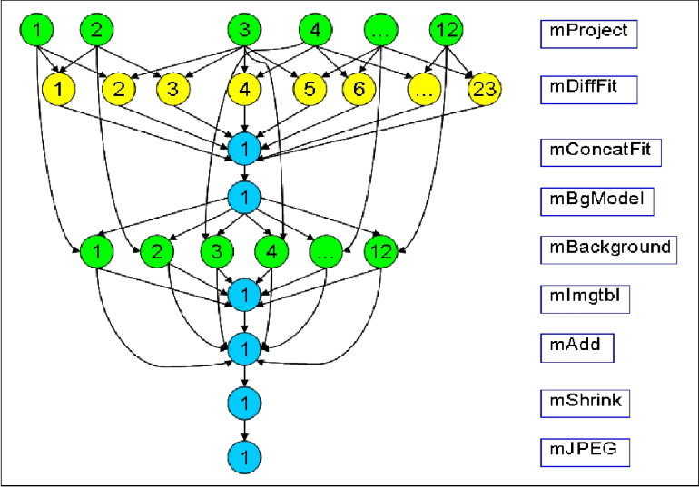
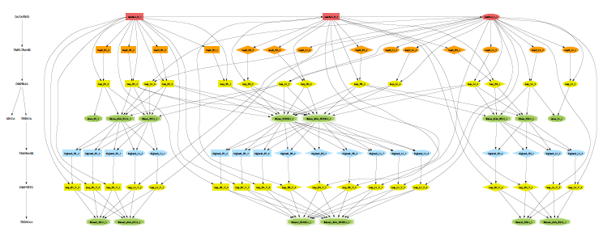
Experimental Study
Execution environment:
140 machines
Workflow applications:
Montage (53 tasks)
LIGO (81 tasks)
Workflow engines:
Condor-DAGMan 7.0
Taverna 1.4.8
Karajan 4_0_a1

Slide 33
Experimental Study
Scheduling policies:
Default
Min-min
HEFT
BMCT

Slide 34
Experimental Study
Input workload:
400 MB
1024 MB
We studied the effect of the scheduling policies.
We measured application makespan
Real executions

Slide 35
Results
Mantage ran on Taverna, DAGMan, Karajan
400 MB input workload
120 executions
Default scheduling policy
Notes:
Reference case to compare when changing the scheduling policy.

Slide 36
Results
Same experiments but using SchedFlow
Min-min, HEFT, BMCT
Rescheduling
Notes:
Engines used for dependecy management and monitoring.
Makespan is reduced when using user-supplied scheduling policies.
In this case BMCT is the best policy. Makespan reduced around 30%.

Slide 37
Results
Mantage ran on Taverna, DAGMan, Karajan
1024 MB input workload
120 executions
Default scheduling policy
Notes:
Reference case to compare when changing the scheduling policy.

Slide 38
Results
Same experiments but using SchedFlow
Min-min, HEFT, BMCT
Rescheduling
Notes:
Now HEFT is the best policy.
Same results with LIGO.

Slide 39
Results
LIGO ran on Taverna, DAGMan, Karajan
400 MB input workload
120 executions
Default scheduling policy
Notes:
Reference case to compare when changing the scheduling policy.

Slide 40
Results
Same experiments but using SchedFlow
Min-min, HEFT, BMCT
Rescheduling
Notes:
Engines used for dependecy management and monitoring.
Makespan is reduced when using user-supplied scheduling policies.
In this case BMCT is the best policy. Makespan reduced around 30%.

Slide 41
Results
LIGO ran on Taverna, DAGMan, Karajan
1024 MB input workload
120 executions
Default scheduling policy
Notes:
Reference case to compare when changing the scheduling policy.

Slide 42
Results
Same experiments but using SchedFlow
Min-min, HEFT, BMCT
Rescheduling
Notes:
Now HEFT is the best policy.
Same results with LIGO.

Slide 43
Conclusions
No single scheduling policy is the best for all scenarios
SchedFlow allows us to obtain better performance providing:
Flexibility regarding scheduling policies
Support for rescheduling
Integration with Workflow Engines
Notes:
Better performance when executing workflows, as it allows to choose a scheduling policy depending on dynamic factors of a particular run.
To include new scheduling policies, both static and dynamic.
In an heterogeneous environment this effect will be magnified: dynamic environment.
Proof of concept.
Open lines: change scheduling policy at runtime, select authomatically the best scheduling policy.
Narrow the gap between scheduling policies and workflow engines.

Slide 44
Using SchedFlow for Performance Evaluation of Workflow Applications
Elisa Heyman
Gustavo Martínez
Miquel Angel Senar
Emilio Luque
Universitat Autònoma de Barcelona
Elisa.Heymann@uab.es
Barton P. Miller
University of Wisconsin
bart@cs.wisc.edu
44
Notes:
Vulnerability Assessment and Secure Coding Practices
44

